Slide 1
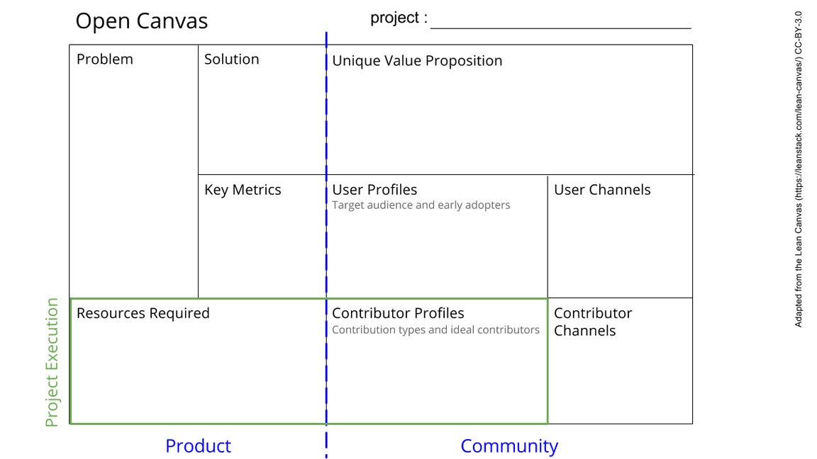
More stable is more better!
The experiments need a certain amount of stability. Two forms:
Active (leveling the experiment)
Passive (filter out vibration)
PID controlled leveling system
Rigid coupled spring system
Due to the fact that both isolation-material and our stability-material needs space, we decide the size of the experiment (internal size of the box). Also, because of the use of springs, there can only be a certain amount of weight inside of the internal box.
Every x seconds, the box needs to be level in radian
Large traffic needs to be filtered out
We make/will have made a rail-system, so multiple experiments can be put within the box.
Build for experiments that need stability and need to be level
Not yet entirely certain, but:
PID controller, springs, Pneumatic Springs, (probably) plastic box, rails?
Specs of the outside box and inside box….
-
See next slide for instructions!
Notes:
Go to File > Make a Copy… to make your own canvas
See next slide for instructions

Slide 2
